Slide 1
Automated In-Plant Line Inspection Reporting System
Jufrey Niño E. Bayog
John Paul S. Bobila
Systems Development
PIMD-ICT

Slide 2
Presentation Outline
Background
Advantages
Data Gathered
User Roles
Process Flow
Swimlane
Database Structure

Slide 3
What is the NMIS AIPLIRS
The Automated In-Plant Line Inspection Reporting System (AIPLIRS) is a system that can be use by the Plant Operation Standards and Monitoring Division for generating report of Inspection such as Antemortem, Postmortem and Diseases at real-time reporting.
It generates and help the office for the Monitoring of daily report, monthly report

Slide 4
Advantages
Provide an real-time report specially for the Central office
Provide an efficient way of reporting of every Meat Inspection Officer, Meat Establishments, POSMS, POSMD
Monitoring of Post-mortem, Ante-mortem
Disease reports

Slide 5
Data Gathered
Conduct interview on the End-User(POSMD) for the process flow
Conduct interview on the IT unit for the process flow in AIPLIRS developed by third-party
Process Flow manual
Form for reporting (DMIR, MMIR, DRR)
Example output for the reporting
Access to the system developed by third-party(AIPLIRS)

Slide 6
User roles
ME
Manage the Daily Receiving Report.
MIO
Manage the plants assigned.
Manage the Daily Meat Inspection Report.
Manage the Monthly Meat Inspection Report.
Manage the Diseases report

Slide 7
User roles
POSMS
Manage the plants under region.
Approve or return for correction on the submitted Daily Receiving Report.
Manage the Daily Receiving Report under region.
Manage the Daily Meat Inspection Report under region.
Manage the Monthly Meat Inspection Report under region.
Managing the Diseases Reported under region.
POSMD
Manage all plants.
Manage all Daily Receiving Report.
Manage all Daily Meat Inspection Report.
Manage all Monthly Meat Inspection Report.
Managing all Diseases Reported

Slide 8
Meat Establishment
Receiving of live animals from the meat dealer
Validate documentary requirements
Viewing of Daily Report Received (DRR)

Slide 9
Meat Inspection Officer
Conducting Ante-mortem and Post-mortem inspection
Generates report for the POSMS, POSMD

Slide 10
Plant Operation Standards And Monitoring Section
Manage the plants under region.
Manage the Daily Receiving Report under region.

Slide 12
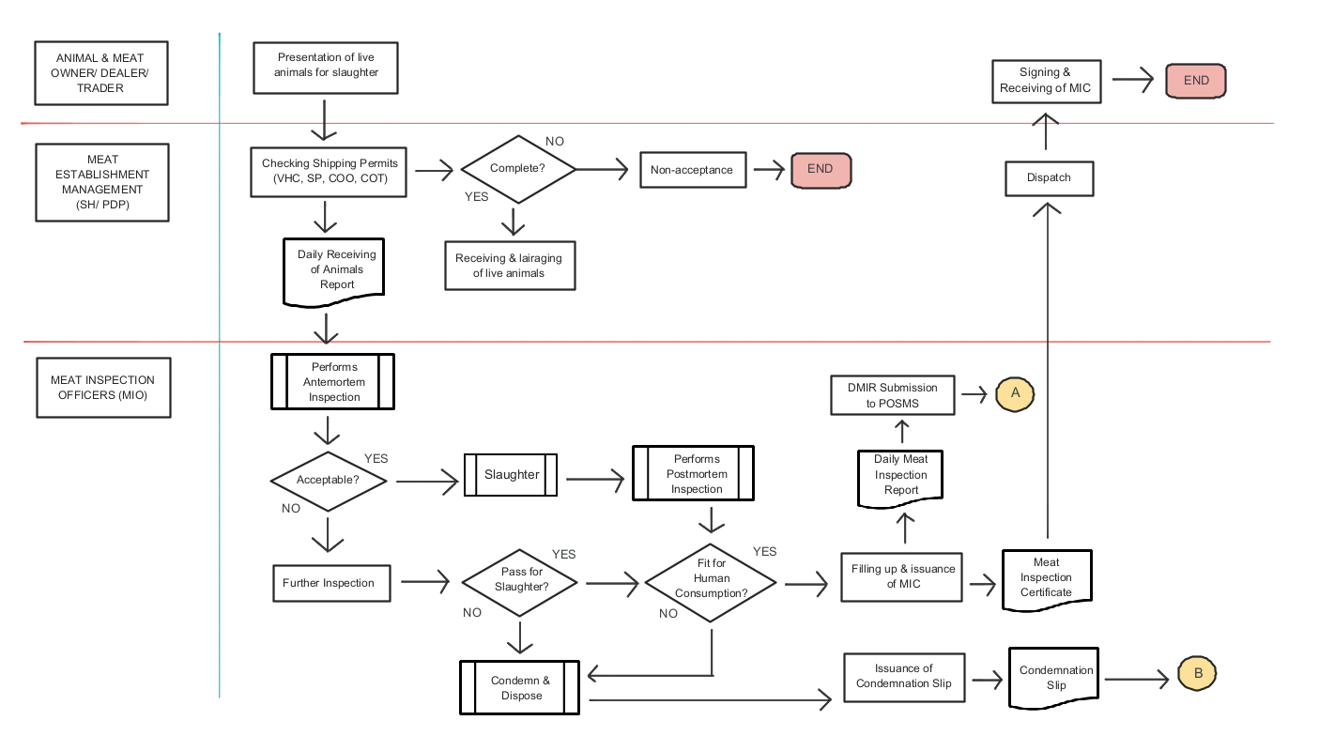
Process Flow

Slide 13
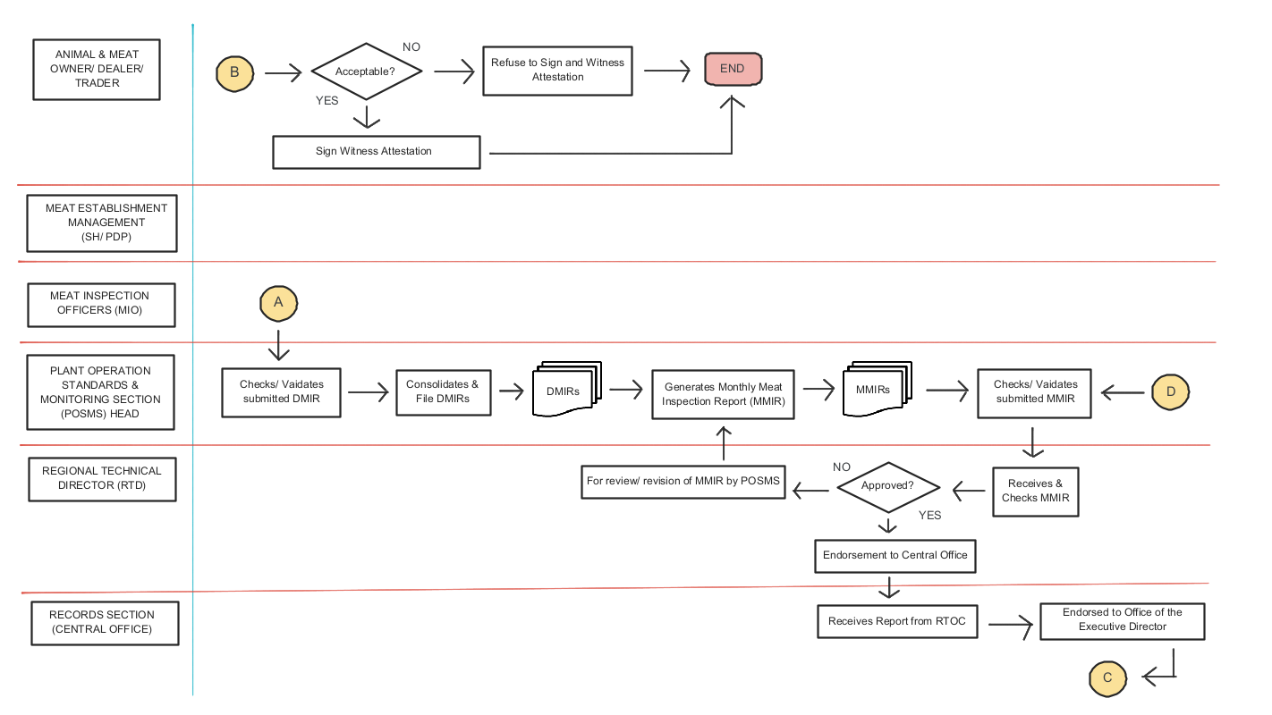
Process Flow

Slide 14
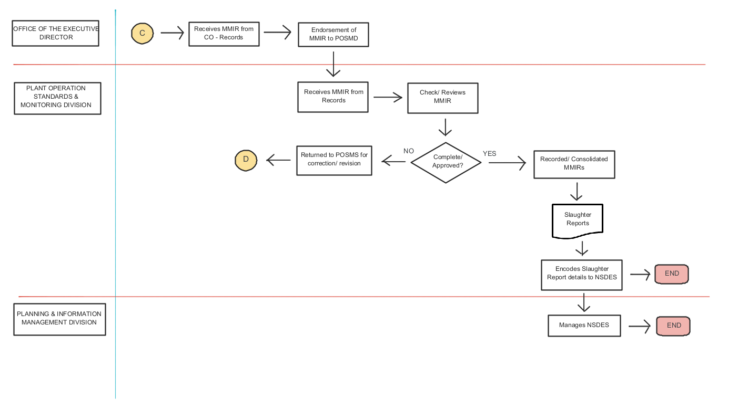
Process Flow

Slide 15
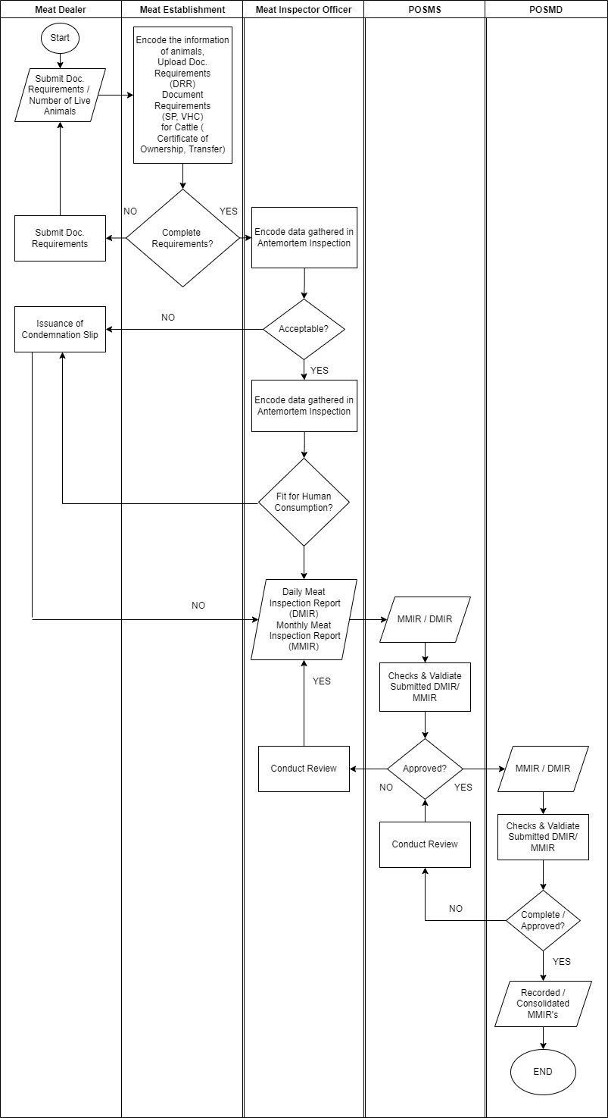
Swimlane

Slide 16
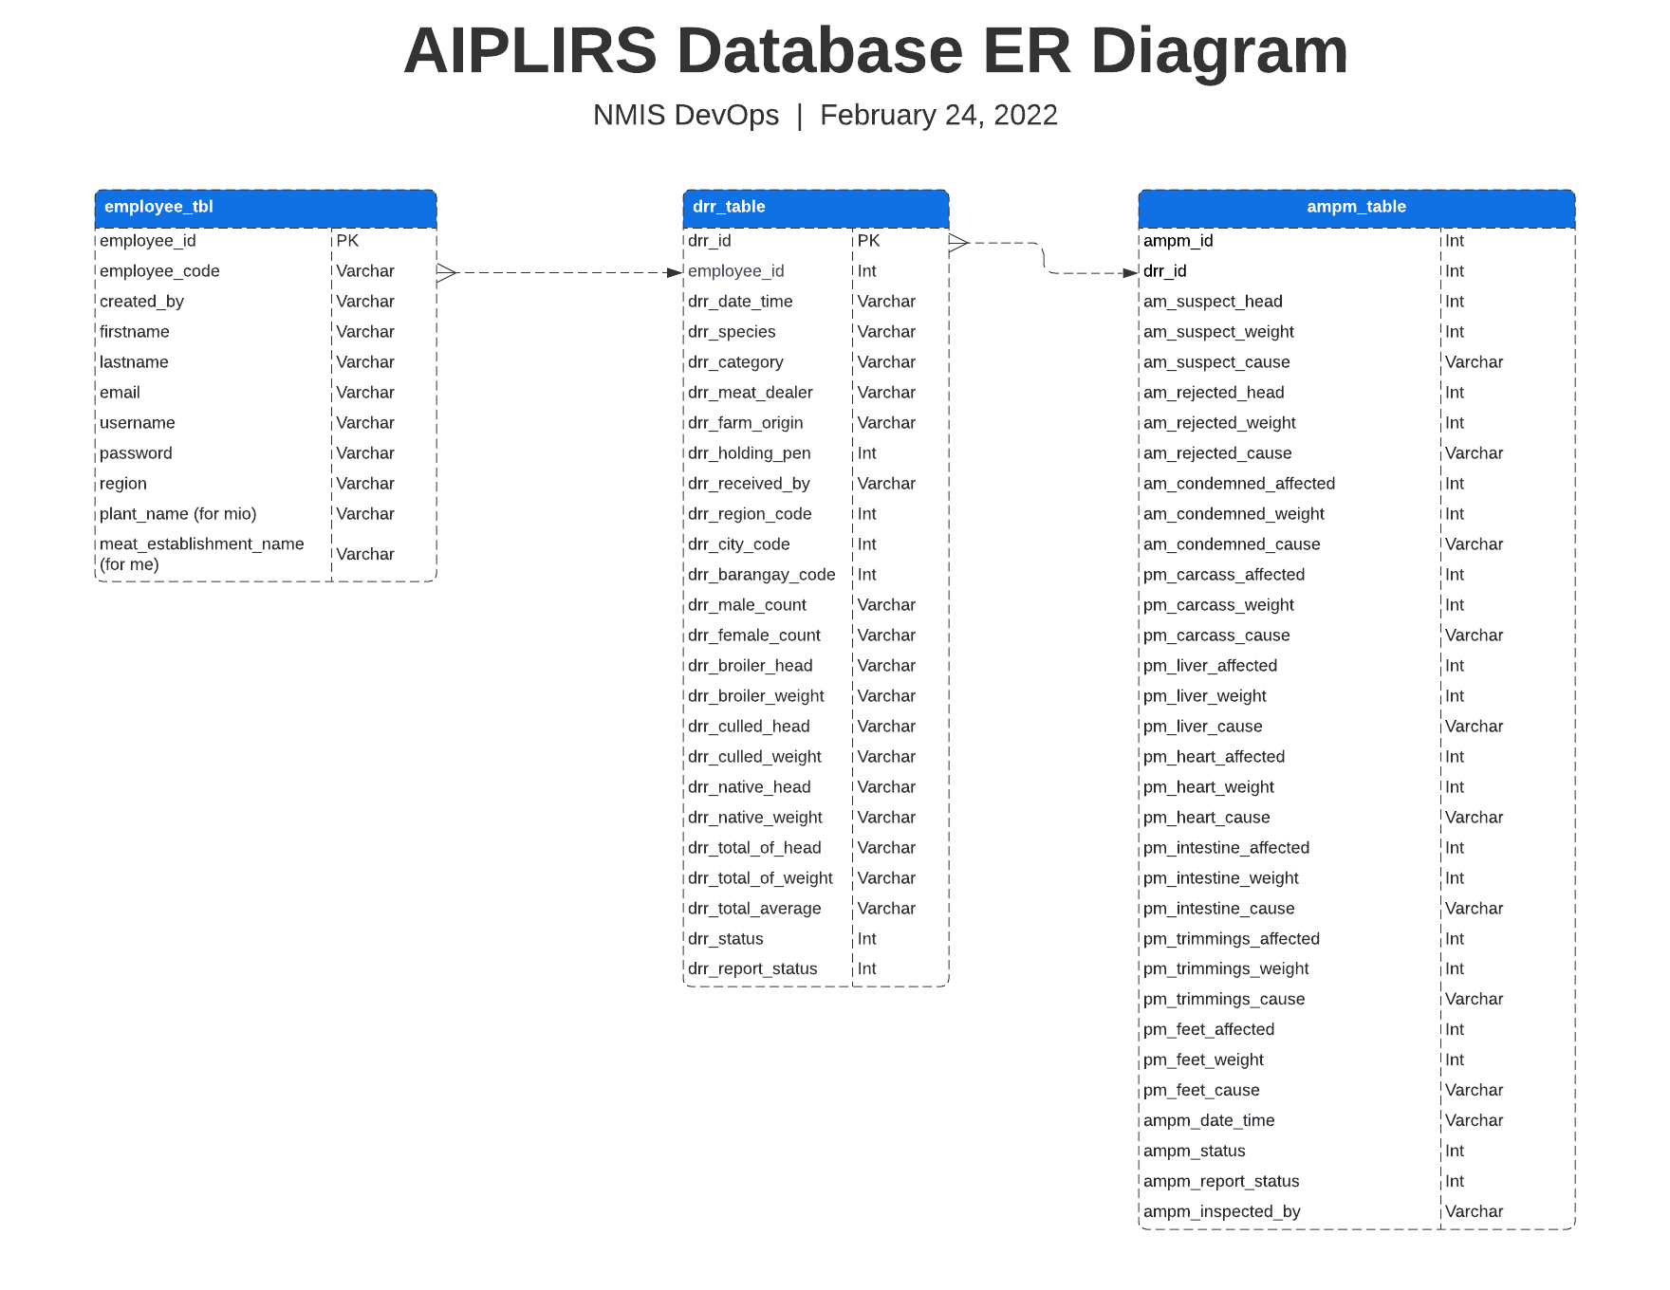
Database Structure

Slide 17
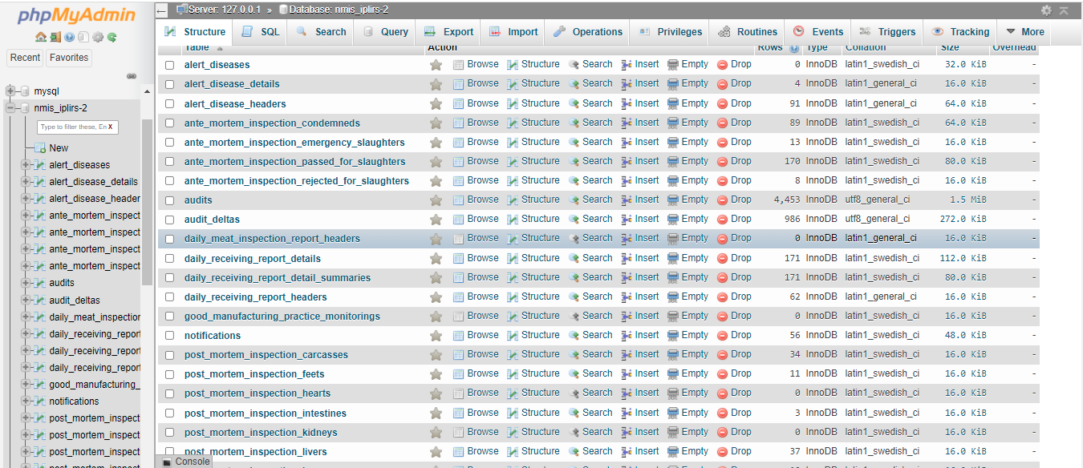

Slide 18
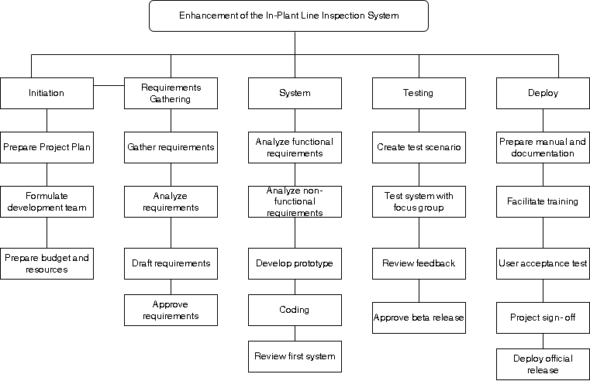
Work Breakdown Structure

Slide 19


